Slide 1
MediStore Manager
Database Management System for a Medical Supply Store

Slide 2
Contact Information
Jackson Rodgers - rodgerjk@mail.uc.edu
Kevin Sherman - shermakc@mail.uc.edu
Advisor: Seokki Lee - lee5sk@ucmail.uc.edu

Slide 3
Abstract
MediStore Manager is an application to be used by medical supply stores to help manage their inventory. It is designed to be able to be used without any knowledge of the database structure and to provide a smooth workflow for day-to-day operations. Equipment, patients, and suppliers will be stored within the custom database along with all relevant information. The user can view and update this information, along with adding new equipment, patients, or suppliers. They may also print work or order tickets through this application as needed. The application will also allow the user to track any item, patient, or supplier’s prior history with the store.

Slide 4
User Stories
As an employee at a Medical Supply Store, I want a system in place to ensure inventory is properly managed.
As a technician, I want to print work tickets to provide a receipt to patients of equipment provided. I want to be able to use the system to view all previous work tickets.
As an employee, I want to print order tickets to keep track of equipment purchased from our suppliers but not yet received. I want to be able to use the system to view all previous orders.
As an employee, I want to search for patient information to expedite the process of providing equipment.

Slide 5

Design Diagram - D0

Slide 6
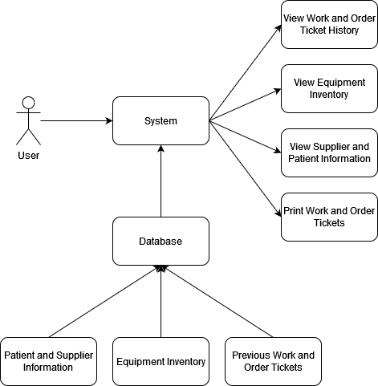
Design Diagram - D1

Slide 7
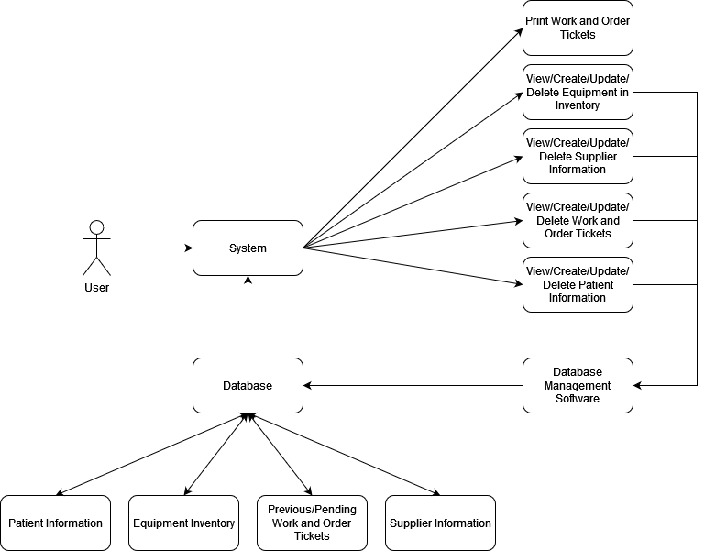
Design Diagram - D2

Slide 8
Constraints
Relying entirely on freeware
Community version of MySQL Workbench
Open source
Must follow the guidelines of the GNU General Public License
Required to use Oracle’s open source MySQL software
High Security
Will be handling customer data including medical records
Must implement multi-layered security protocols

Slide 9
Current Progress
Types of data to be stored in each database table has been specified
Interconnected table structure for database has been designed
Components required for user interface have been specified
Mockup of the user interface has been created

Slide 10
End of Term Deliverables
Database
Local server for housing the database
SQL scripts for generating the table structure
SQL scripts for populating the database
User Interface
Application platform
Pages and button layout
No interaction with database

Slide 11
Division of Work
Jackson
Specify required components for User Interface
Develop Application Platform
Design and develop User Interface
Test and refine all aspects of Application
Kevin
Design interconnected table structure for Database
Create local MySQL server and develop tables through MySQL workbench
Develop the connection between Application and Database
Develop unit tests for connection code

Slide 12
Expected Demo
Fully functioning application connected to MySQL database populated with relevant data
Interact with the UI to showcase all available operations such as
Adding/Updating a Patient/Supplier/Equipment
Viewing additional information for a Patient/Supplier/Equipment
Printing Work/Order tickets

Slide 13
FIN

